Slide 1
BOOK RECOMMENDATION SYSTEM
A CONTENT-BASED FILTERING FRAMEWORK

Slide 2

EXECUTIVE SUMMARY
Project Philosophy
This project introduces a zero-dependency recommendation engine designed for high-performance literary discovery. By utilizing a pure Python backend and a lightweight Vanilla JS frontend, the system delivers sub-100ms similarity scoring without the overhead of external libraries.

Slide 3






ARCHITECTURAL PRINCIPLES
Standalone Engine
LRU Optimization
Metadata Driven
Built using native Python HTTP libraries to ensure maximum portability across server environments.
Implements Least Recently Used (LRU) caching to handle recurring similarity queries with instantaneous response times.
Leverages multidimensional book schemas (Genres, Keywords, Author Bias) for granular recommendation accuracy.

Slide 4

MATHEMATICAL SCORING ENGINE
→
Genre Dominance (2x): Prioritizes thematic alignment to ensure fundamental category matching.
→
Keyword Synergy (1x): Captures subtle narrative nuances such as "Dystopia" or "Strategy".
Weighted Similarity Algorithm
→
Quality Bias (0.2x): Normalizes the score based on community-verified ratings.

Slide 5
SCHEMA SPECIFICATION
Object Key | Data Type | Functionality in Filtering
Genres | Set / Array | Core Categorization (Primary scoring weight)
Keywords | Set / Array | Semantic Refinement (Secondary matching)
Rating | Float | Quality Validation (Tie-breaker logic)
Year | Integer | Temporal Sorting (Chronological organization)

Slide 6
THE BACKEND CORE
Python Efficiency
Our backend eliminates the need for heavyweight frameworks like Flask or Django. By extending BaseHTTPRequestHandler, we achieve a lean memory footprint.
The ContentBasedRecommender class encapsulates all logic, providing a clean separation between data ingestion and algorithmic scoring.

Slide 7

ASYNCHRONOUS UX
Dynamic Interaction
API Endpoints: /api/books (Search/Sort) /api/recommend (Similarity)
The frontend utilizes the Fetch API for non-blocking I/O. Users receive instant search feedback and recommendation updates without page refreshes.

Slide 8
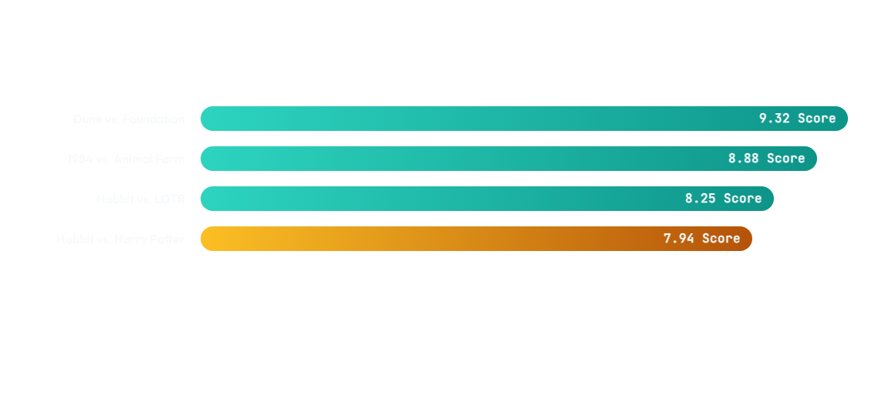
PREDICTIVE ACCURACY (EXAMPLE)
The visualization demonstrates high confidence scores for seminal Science Fiction and Fantasy pairings based on metadata synergy.

Slide 9
SYSTEM PERFORMANCE
128
Optimized Throughput
By leveraging Python's lru_cache, the system stores the 128 most frequent recommendation pairs in memory. This reduces computational complexity from O(N) to O(1) for high-traffic queries, ensuring a fluid user experience even with expanding datasets.
CACHED STATES

Slide 10
SIMILARITY VISUALIZATION
Network of Knowledge
Our algorithm treats books as nodes in a high-dimensional space. The "distance" between any two books is calculated via set intersections of genres and keywords, effectively creating a virtual topology of user interests.
This approach solves the "Filter Bubble" problem by introducing weighted serendipity through quality ratings.

Slide 11

Thank you for listening!
Efe EFENDİOĞLU - 221005034
Saliha Zümra MERALLI - 221005044
127.0.0.1:8000
Python Native Stack

